Slide 1
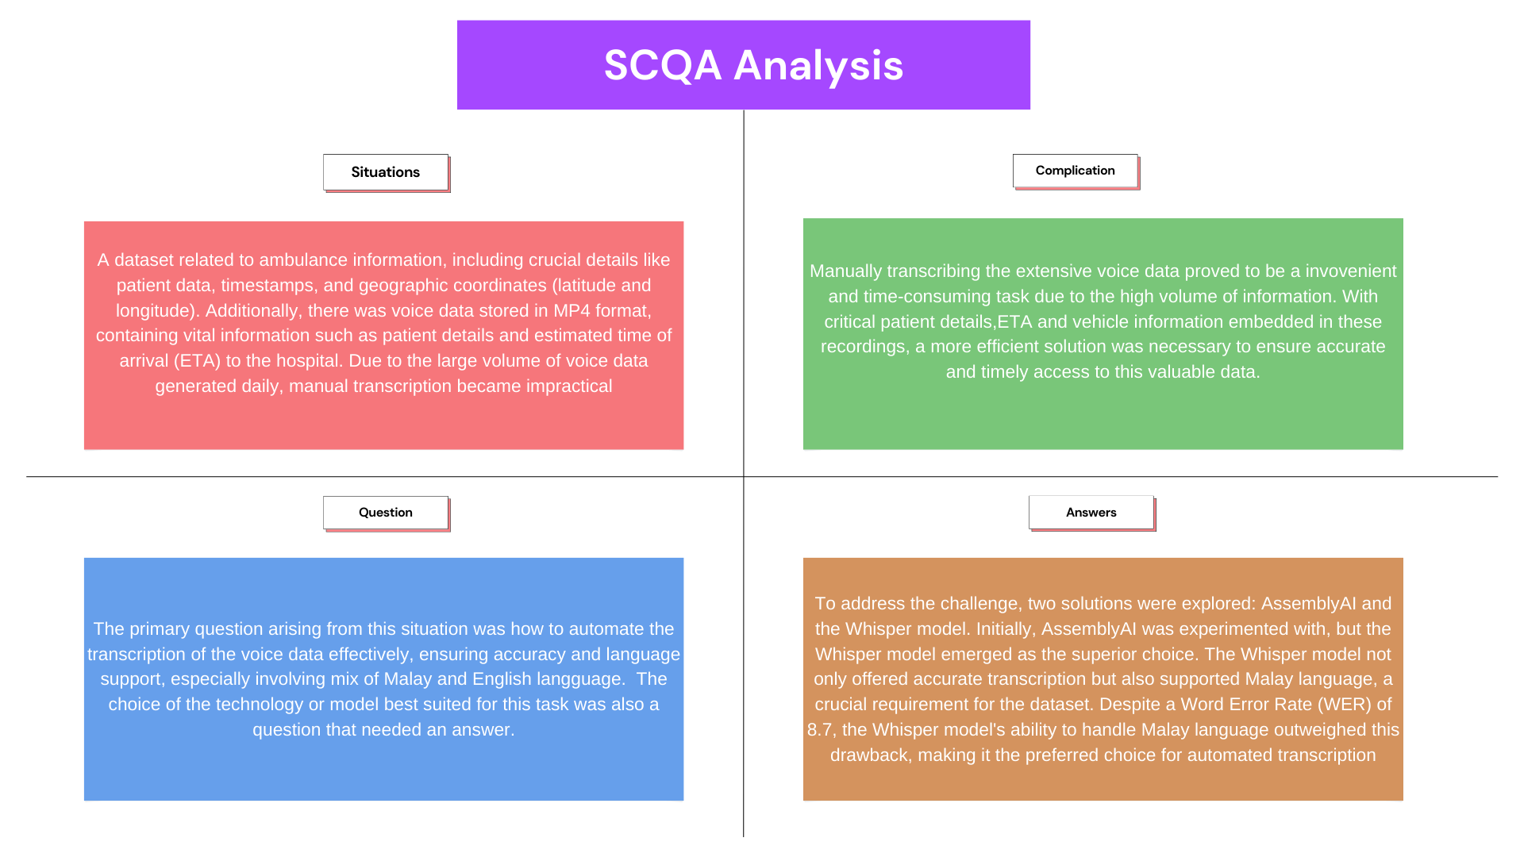

Slide 2
Whisper VS AssemblyAI
Features | OpenAI (Whisper-1) | AssemblyAI
API Key | OpenAI API Key | AssemblyAI API Key
Pricing | $0.006 / minute | 0.015 / minute
Language Support | Multiple Languages Supported | English and several potential languages
Audio Formats | Multiples format type | Multiples Format Type
Customization | Prompting, Fine Tuning (possible) | Customize to some extent (e.g., Sentiment detection, summarization)
Accuracy | High but depends on the input | High but depends on the input
File size | 25mb max – if more need to separate into chunks | 5gb file size 10 hours max file duration

Slide 3
Output Comparison with different files (Whisper Model)
File: 1693030500949-voice_record_1693030420671
With specified output language (English)
My name is Charlie, from KD04. We are transporting a liver patient from KK Taman Esen. The patient is 13 years old, male, Malay, NKMI, NKDFA, LHNBA, lowly versus bicycle. This morning around 8.30am. The patient was cyclist. Post-trauma, he has pain over right shoulder and right preauricular frontal area. The patient has RA, no LOC, no vomiting, no ENT bleed. GCS on arrival, the patient is unconscious. There is no kidney, GCS, full airway pattern, lying position. CCTV are good, lung clear. Vital sign patient, 12186, SQRQ190, room A, pulse rate 90. We have installed cervical collar and spinal board. We have set a line, 20G at right brachial. We have dredged the patient to yellow zone. Hospital Selayang, DTA, 10 minutes, over.
Some words are not transcript correctly.
Medium background noise
Clear voices
File: 1693033135594-voice_record_1693033074563
With specified output language (English)
Patients sustained injury at right lower limb, he had deformed at right lower limb. Then there was laceration wound at right foot and forehead, not actively. On arrival, patient alert, conscious, ECS full, not technique, security less than 2 seconds. Vital signs BP 150.85, heart rate 72, SpO2 99, under room air. We have given trauma with mezzolone, with RIT, with spleen, his leg, right side, below. We are taking yellow Xanesta, EPA 10 mg.
Lot of words can’t be detected.
High background noise
Muffle voices

Slide 4
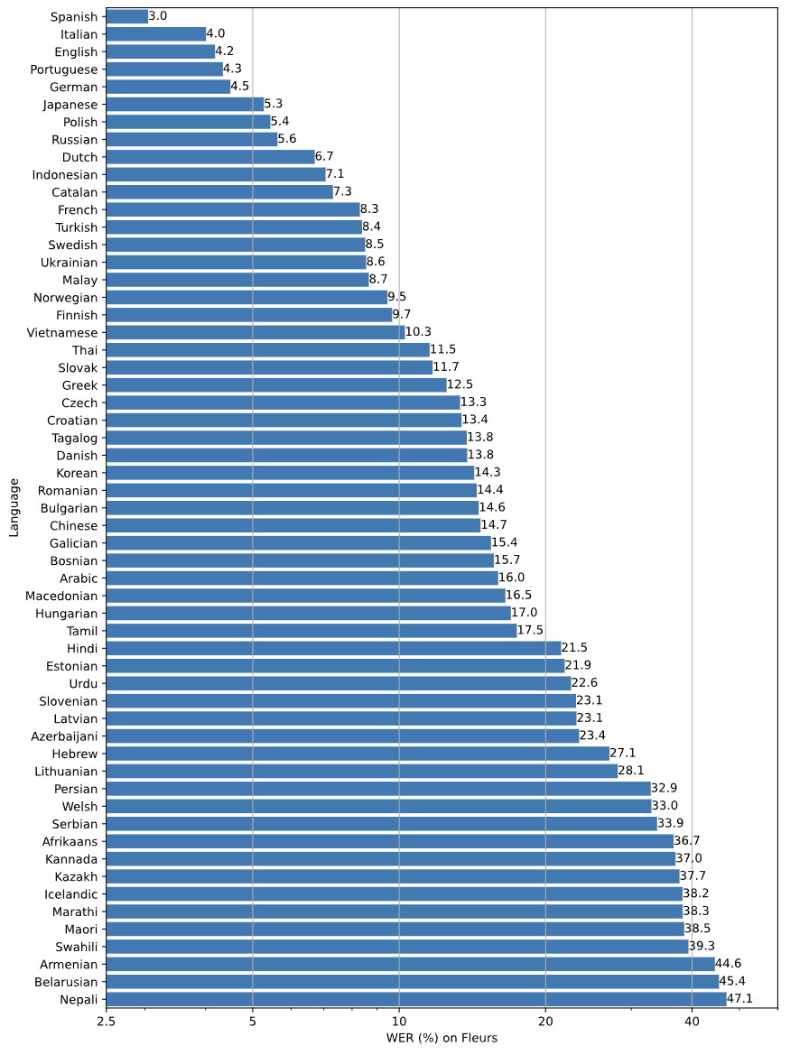
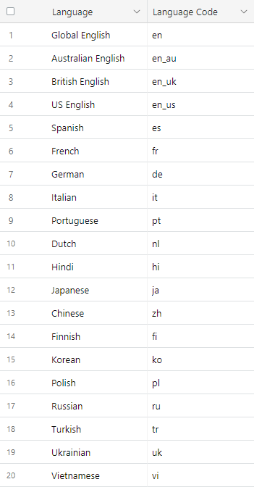
Whisper Supported Language
AssemblyAI Supported Language

